Slide 1
National Emergency Rental Vehicle- NERV Overview

Slide 3
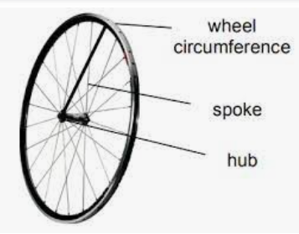
NERV is like a wheel
Each part must work together in order to keep rolling!
Enterprise
Takes reservations
Cancel reservations
Provides vehicles
Sets store locations and hours
Provides Rental Agreements
US Forest Service
Administer the program according to Federal Procurement Regulations
Administer the NERV website
Collects user packets and matches with rental invoices
Pays invoices
Claim determination and findings
Not so obvious – we do not have access to reservations – only Enterprise has that access
Users & Dispatch working together
Makes reservation
Utilize Enterprise vehicles
Submit user packets
Document damage

Slide 4
Is NERV for you?
NERV is for incident personnel with an established need (RO), who have no other means of acquiring transportation for the assignment.
AD Drivers – please read the Statement of Driver and Supervisor Responsibilities
Pool vehicles (but NOT A SUPPLEMENT TO FLEET) (max rental is 120 days)
NERV is NOT:
for non-emergency use (prescribed fire, training, preparedness)
for self-sufficient Overhead resources without a need for an HD vehicle
Anyone mobilized to an incident with an agency provided means of travel reimbursement should use that system to rent a vehicle for incident use without an HD vehicle.
Notes:
Add a link to the new NERV SOP

Slide 5
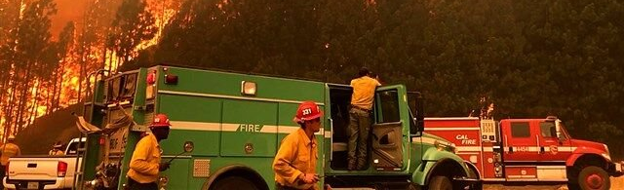
Benefits of nerv:
Accessible to multiple agencies, State, National Parks, Military, and FEMA
Access to HD trucks – 2hr confirmation weekdays (closed on weekends)
Claims are processed by the NERV team
Available to non-self-sufficient users

Slide 6
This guide cannot address ALL situations. https://nerv.firenet.gov/
Please consult the NERV Standard Operating Procedures for further guidance.
Notes:
If you have a situation outside of this guide that is NOT for Pool related vehicles, please contact us for help.

Slide 7
Three phases of the NERV Rental
1. Vehicle reservation/pick up
2. Vehicle use
3. Vehicle return/close out
Notes:
When returning an HD vehicle, you will need to make sure that the location at which you intend to return the vehicle, accepts HD vehicles. Not all locations accept HD vehicles.

Slide 8
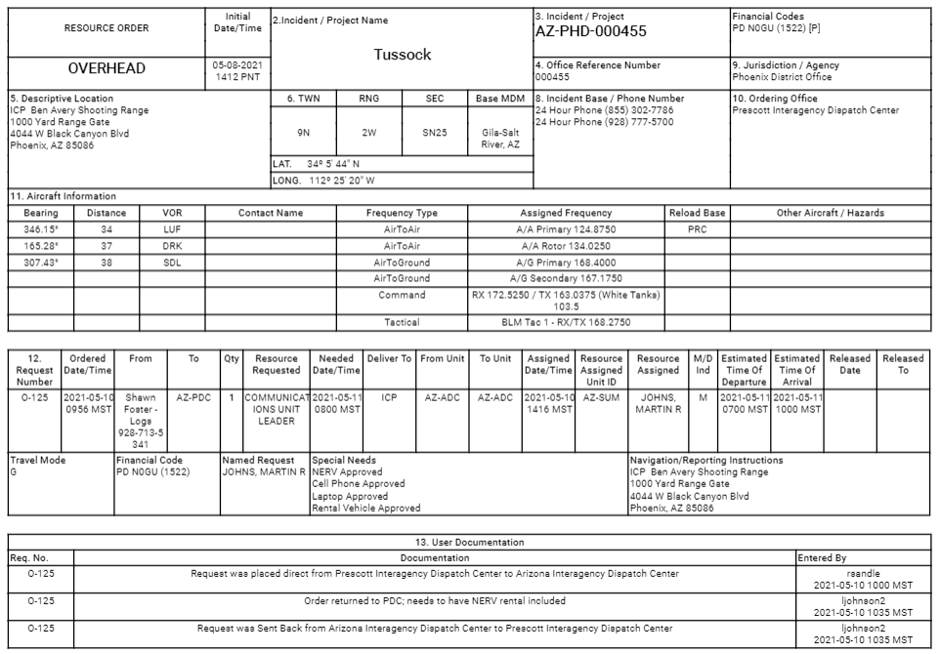
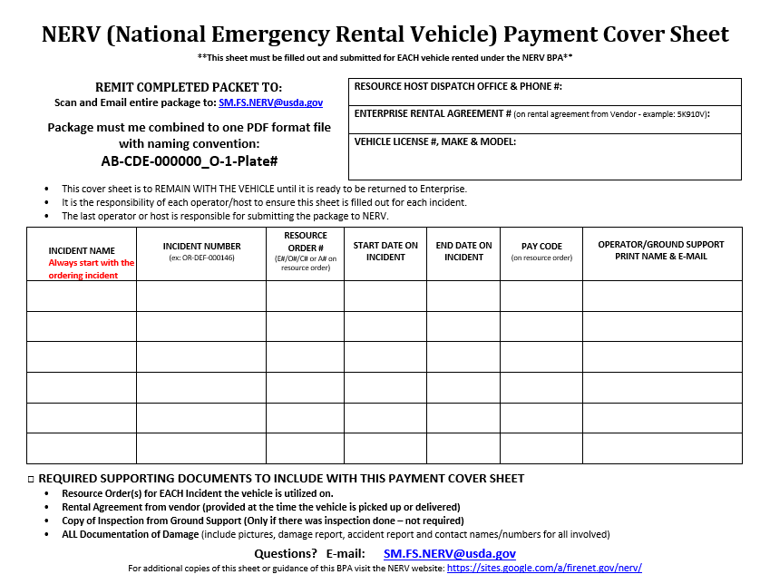
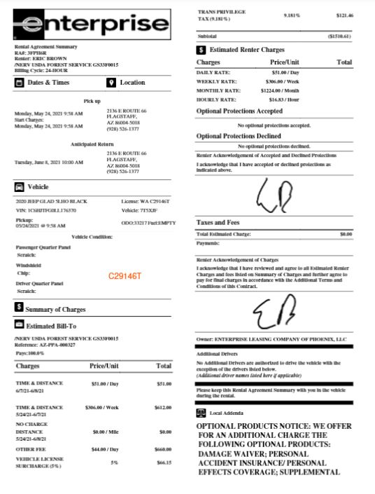
Phase 1: Vehicle Pick Up/Set Up
When mobilized and NERV is approved:
1. Email the RO¹ sm.fs.nerv@usda.gov. 2. Set up the Cover Sheet²: Enter the information on the RO on the top line of the Cover Sheet and the boxes on the top right.
Take the RO to the local Enterprise Rental Center – Provide the RO to the Agent. 4. KEEP the Rental Agreement⁴ you are given from the rental agent – All pages. 5. Put all three user documents ^{(1, 2, 3)} together for use in the next steps. (Envelope/folder?)
PDF format is required for all documentation, including pictures
1
2
3
Notes:
For additional help with completing the cover sheet for various situations, please see the NERV Payment Cover Sheet directions document.

Slide 9
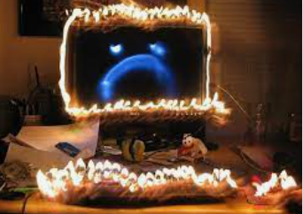

Slide 10
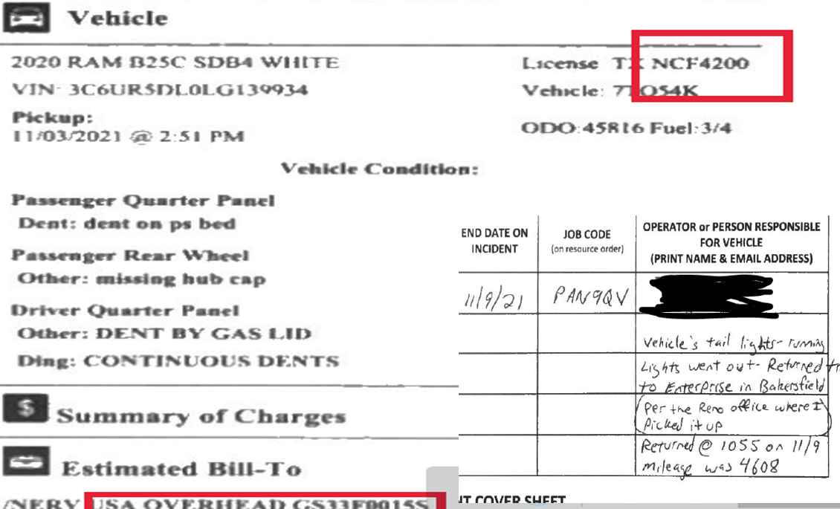

Slide 12
Phase 2: Vehicle use
If the you and the vehicle are re-assigned to another incident, complete the next line of the Cover Sheet with the new incident information. Continue to record re-assignments as necessary.
Keep a copy of the RO from EACH incident with the existing package.
Vehicles in rental status for over 30-days – see “Vehicle Rented Over 30 Days” slide.
If any damage occurs to your vehicle while in use, complete an SF-91, SF-94 or the host agency’s damage documentation form and/or police report. Keep a copy with your user documents. See Damage Slide.
Remember – only dispatch can transfer a vehicle to another user!

Slide 13
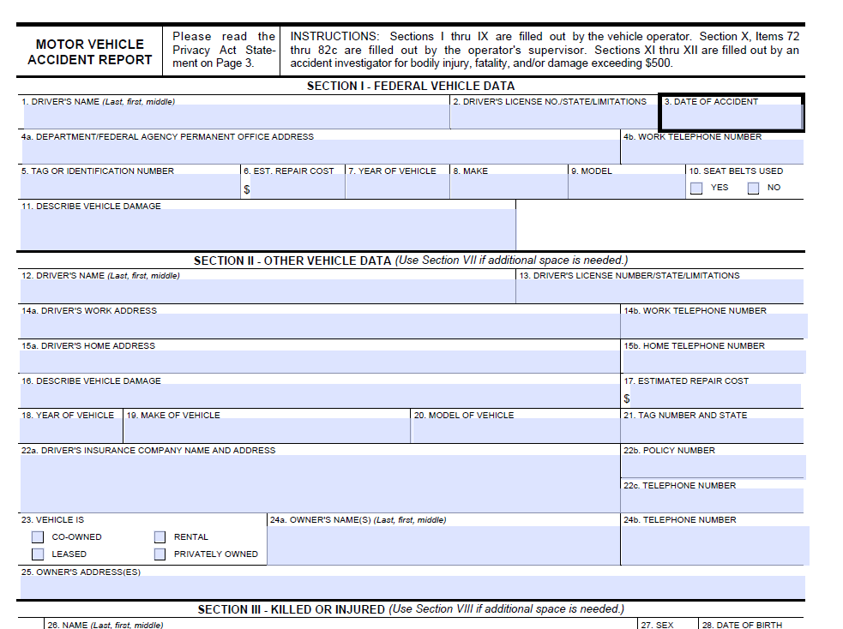
Phase 3: Return/Close out
When the assignment is over, return the vehicle to an Enterprise location.
KEEP the package of documentation you have been compiling.
Scan all the documents to one PDF format file in this order:
Cover Sheet(s)
Rental Agreement (all pages)
Resource Order(s)
Damage documentation
Incident inspection sheets if available (not mandatory)
Send all documents in ONE PDF file to sm.fs.nerv@usda.gov.
Notes:
For Pool Vehicles: If sending documents for more than one vehicle, send one file per user package per vehicle. DO NOT COMBINE DOCUMENTATION FOR MULTIPLE VEHICLES INTO ONE FILE.

Slide 14
Rental payments are due every 30-days – so your user package is needed every 30 days.
Examples of 30 Days =
July 1 through July 30 OR
July 7 through August 6
Vehicles rented longer than 30 days
A user package MUST be submitted every 30-days (not month, not 4 weeks, ~ 30-days)
After submitting, the updated cover sheet and package can continue to be used and submitted at the 60- and 90-day mark too.
Maximum rental duration = 120 Days Vehicle must be returned before then.
Return to Phase 2 side

Slide 15
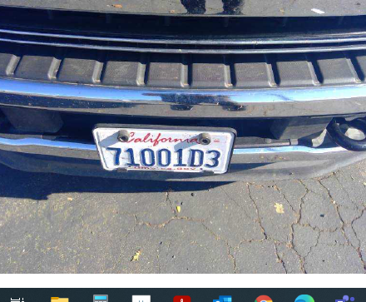
Have you seen Me? Please do not dump vehicles

Slide 16
Accidents happen – make this situation better by reporting it.
OOPS!
If your vehicle is damaged during your rental, complete the SF-91 or SF-94 or agency required damage documentation.
Submit the damage documentation with the user package.
If a third party is involved or at fault, make notes on the damage documentation. Obtain a copy of the police report
Ensure that your home unit supervisor, incident unit supervisor, and home dispatch center are notified in the event they are contacted for follow-up information.
Return to Phase 2 side

Slide 17
More on reservations in the NERV UPDATED SOPs
Reservations
As of June 2021, all NERV reservations will need to be made through the dispatch center.
If you are self sufficient or have a government issued travel card and access to a travel reimbursement system such as (ETS, BCD, Duluth, Concur, etc); you are required to book your reservation through your standard travel reservation process.
If there are issues with the reservation, call the Enterprise help desk at 844-665-4702
Notes:
Add updated SOPs link

Slide 18
More on transferring vehicles in the NERV UPDATED SOPs
Transferring Vehicles
Overhead rented vehicle transfers are PROHIBITED.
Dispatch centers are the only facilitators of a vehicle transfer.
Only HD vehicles are eligible for transfer via dispatch.
Return to Phase 2 side
Notes:
Add updated SOPs link

Slide 19
Contact us!
Questions?
If you need help, please reach out for assistance!
Enterprise 855-266-9565 –Roadside Assistance – 800-307-6666
sm.fs.nerv@usda.gov
208-390-4868 - NERV
https://sites.google.com/a/firenet.gov/nerv/home

